Slide 1
Creation and
Evaluation of the model
Create your model from data

Slide 2
Before start: Difference between Parameters and Hyperparameters
PARAMETERS: are the weights that are tuned (optimized) by means of the training
HYPERPARAMETERS: are values that are decided before training. They can be relative to the model (model complexity) but also preprocessing steps.
Training Linear Regression models on data means find the best parameters (weights) that allows the model to describe the data properly. The parameters are found after training phase
For example, in Lasso and Ridge Regression, the hyperparameter is the alpha value (regularization strength). For a Decision Tree, can be the maximum depth of the tree. To sum up, an hyper-parameter control some aspect that is fixed BEFORE training phase.
Now think about regularization LASSO and RIDGE regressions: the parameter ALPHA can be decided before training phase (we decide it before training).
Also, in Polynomial Regression, the maximum degree of the polynomial can be decided before training the model.

Slide 3
Difference between Parameters and Hyperparameters
REMEMBER:
Different Models have different Hyperparameters type (Linear Regression has alpha, Decision Trees has the Depth of the tree, Support Vector Machines has the Kernel parameters…)
Hyperparameters are values that can be chosen before training phase
Hyperparameters set the complexity/flexibility of the models so they control the overfitting of the model to the data.

Slide 4
Steps to create a model for your data
Choose a class of model (Linear Regression? Random Forest? KNN? ...)
Choose model hyperparameters values (deciding the complexity of the model)
Fit the model to the training data and evaluate the model
Once satisfied, measure generalization error on test set to simulate a real usage

Slide 5
How to evaluate the model
(once chosen the complexity by choosing hyperparameters)

Slide 6
Alternative 1: THE NAIVE and WRONG Approach
(NEVER say/do it in a interview)
Never Train model on Training set and evaluate the performances on the same data (Training set)!
In fact, in this case you don’t have a real estimation of the generalization power of the model, because you LEARN and PREDICT on the same data: overfitting is very common in this case and you don’t realize you are overfitting.
Example on the notebook: open CrossValidation_Hyperparameters_Tuning.ipynb
Training set
Train on:
Test on:
Training set

Slide 7
Alternative 2:
Hold out set method
Small Training set
Hold-out-set
Simply take your training set:
Split in 80% (we informally call it small training set) and 20% (validation set) randomly sample
Train on Small Training set, predict on Hold-out-set (also called validation set)
Get the performances (es: accuracy)
This time, the estimation of the model trained is more realistic: we trained on data, and predict on “unseen data” (that the model never saw before).
We assume that the statistical properties of the Training Set and Validation Set are the same (or very similar) - because we assume that they are generated by the same distributions.
Example on the notebook: open CrossValidation_Hyperparameters_Tuning.ipynb

Slide 8
Hold out set method is ok, but...
Small Training set
Hold-out-set
We lost portion of our data for testing and not for training
We randomly sampled 20% for validation set. If for any reason (luckiness) the validation set is particularly “hard” to predict? (imagine that in the test set there’s a under-samples of bananas)
K-fold cross validation is our solution (most common used in practice)

Slide 9
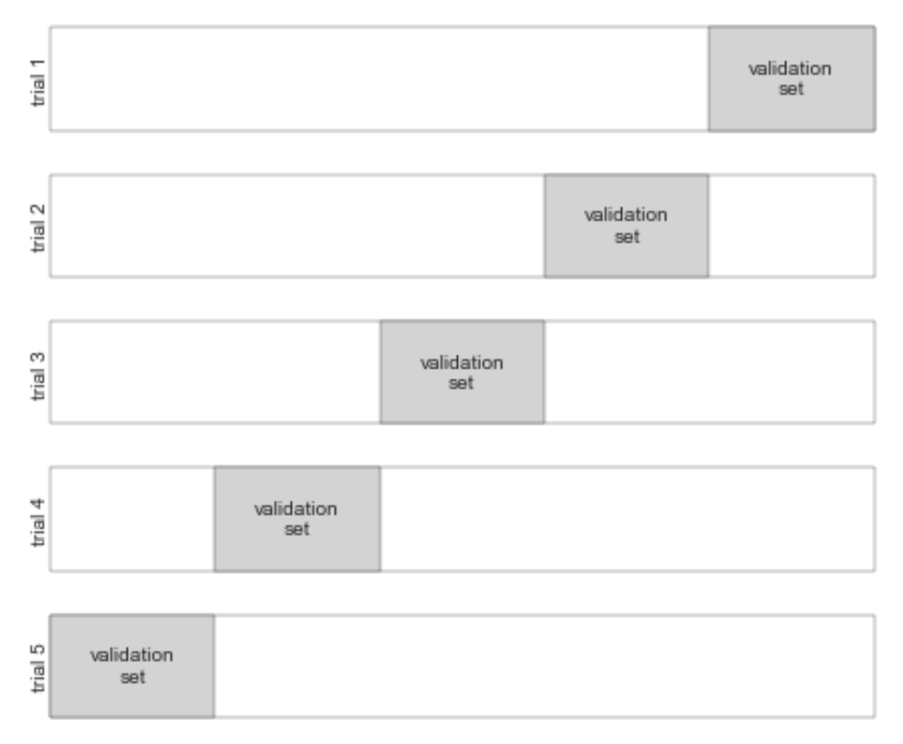
Alternative 3: Cross Validation
Small Training set
Hold-out-set
One way to address this is to use cross-validation; that is, to do a sequence of fits where each subset of the data is used both as a training set and as a validation set. Visually, it might look something like this.
Example on the notebook: open CrossValidation_Hyperparameters_Tuning.ipynb

Slide 10
Now you know how to evaluate a model. But how can we choose the right hyperparameters?
One way to address this is to use cross-validation; that is, to do a sequence of fits where each subset of the data is used both as a training set and as a validation set. Visually, it might look something like this.
Cross-validate for alpha = [0.1, 0.2, 0.3 …….]
For many alphas (regularization values) perform cross-validation and get the results. Then choose the alpha showing the best performances!

Slide 11
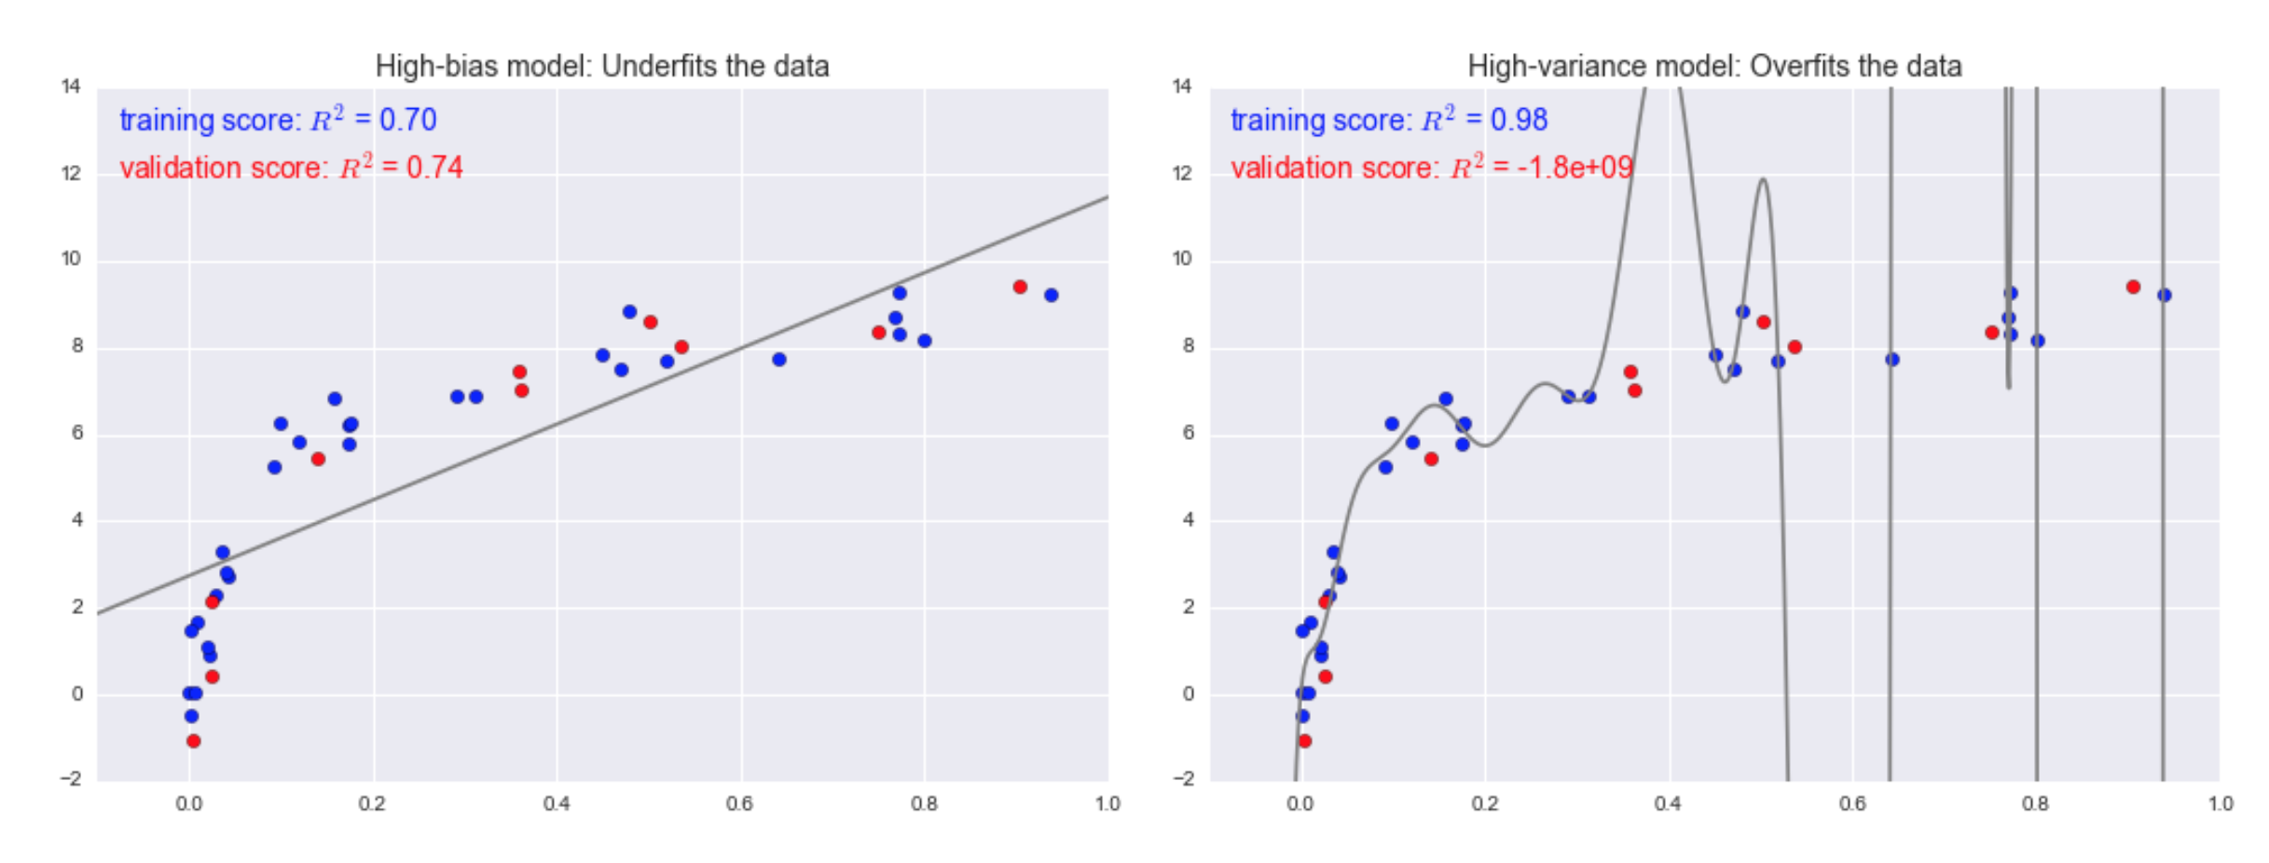
Bias/Variance Tradeoff
On the left, underfitting (high bias): the model is too simple. On the right, the model is too flexible/complex (overfitting). The model captured the random noise in the data. In red the new samples (unseen from the model) and validation scores.
For high-bias models, the performance of the model on the validation set is similar to the performance on the training set.
For high-variance models, the performance of the model on the validation set is far worse than the performance on the training set.

Slide 12
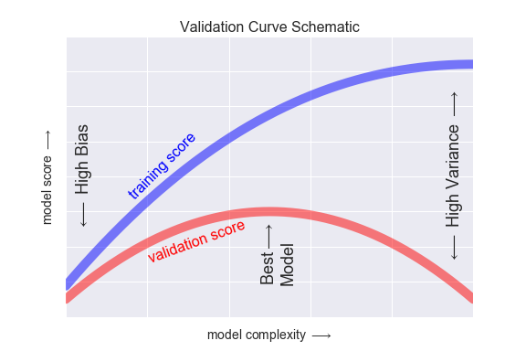
Validation Curve
The validation curve describe the performances (scores) of the model trained on the training set and predicting on training set and validation set.
TAKE HOME MESSAGE: the more complex the model, the worse it performs on the validation set. The best complexity is at the maximum of validation score line. Validation Curve is a graphical tool to understand the best complexity to choose.
For high-bias models, the performance of the model on the validation set is similar to the performance on the training set.
For high-variance models, the performance of the model on the validation set is far worse than the performance on the training set.

Slide 13
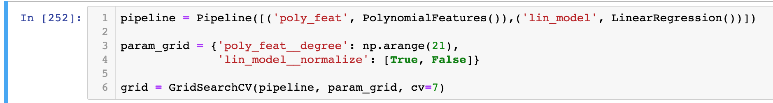
Grid Search: the best way to choose the model complexity
GridSearch is a common way to hyperparameter tuning (choose the best hyperparameters)
It works choosing a “grid” of possible hyperparameters and performing a cross-validation on them.
The GridSearch automatically perform a k-fold Cross Validation with different hyperparameter combinations.
For example:

Slide 14

What to do when the model is performing bad?
Sometimes can happen: the model is not performing well. We can first of all understand if the model is overfitting or underfitting.
In case of overfitting, the training set score is high while the validation score is low. What to do in this case?
Use a less complex model
Use regularization techniques (if available for that particular model - Linear Regression have)
In case of underfitting (high bias) the score on training set and validation set are low. The solution could be:
Increase the complexity of the model (each model has its techniques)
Add more information to your data: maybe data are informative enough, so you can add more dimensions (features) to your samples. (remember example of parabola with line)
The rationale behind this can be explained with the “Validation Curve”: this curve helps to find the optimal complexity of the model, since it maximize the Validation set scoring.

Slide 15
Source of this lesson
We strongly advise to read THIS, an excellent article about Model Validation.
Bonus track: we did not talk about “Learning Curves”, you can read it in the link.
We skip it on purpose to make the lesson lighter, but we are available to talk about it !!!

Slide 16
Notebook CrossValidation Session 15

